Slide 1
A Few Housekeeping Items
Juniors

Slide 2
MOST POINTS ARE LOST TO:
CARELESSNESS: simple grammatical mistakes, capitalization, spelling, punctuation, spacing
EVIDENCE-absent or not introduced
EXPLANATIONS-absent or no sentence starter
CITATIONS-parenthetical citations should ONLY have the author (Smith). Or title (“Red Roses”). NOTHING ELSE, no urls or dotcoms, or dot anything

Slide 3
BE CAREFUL OF Commonly confused words
There
Place, like here or there
Their
Pronoun that shows possession…It is their house so it is their problem.
They’re
A contraction for They are -> theyare->they’re
The apostrophe replaces the ‘a’ in this case

Slide 4
Pronoun Problems
Too many pronouns
Check your papers for pronouns and replace them with the nouns to which they are referring. For example:
it -> the government
their -> the government’s
them -> the government
you -> the constituent
her -> Jane
he -> Joe
him -> Joe
she -> Jane

Slide 5
Pronoun Problems (examples from actual papers)
It can slow reaction time.
This was a topic sentence.
What is “it”?
Answer: Marijuana

Slide 6
Evidence andExplanations
EVIDENCE is the information from your research that supports your main points.
EXPLANATION should tell the reader what the evidence means in the context of your paper/thesis.
Evidence is the quote, statistic, example or some other fact/quote to back up what you are already saying (using the CONTEXT/Evidence sample sentences as a guide on how to present your evidence).
To just say in your paper that—Joe Jones supports my thesis by saying it is dangerous—tells the reader nothing.
Try instead—Joe Jones states that, “by slamming one’s head against the wall, the frontal cortex of the cerebrum is severely damaged influencing your cognitive abilities” (Jones).
Then explain—What this means is that if you intentionally hit the wall with your head, you will injure the part of the brain that makes you a person, and eventually you will lose your ability to speak, think, and breathe.

Slide 7
PARENTHETICAL/IN-TEXT CITATIONS
There are ONLY two types I should be seeing in your papers.
The author’s last name. This is ALWAYS your first choice for a parenthetical citation. It looks like this (Smith).
The title of the article. This is the option if there is NO AUTHOR listed. It looks like this (“Red Roses”).

Slide 8
Page Numbers
Make sure you insert page numbers on final paper. In Google Doc, go to Insert, then click on Page number. In the drop down menu click on Top of page and a number will appear in the upper right hand corner of your paper. Place your cursor to the left of the number, type in your last name, then insert a dash after your name…no spaces . The paper will automatically number itself from here on out. ☺

Slide 9
Heading/Titles/Page Layout
Heading—upper left corner, double-spaced, 4 pieces of information
Smith-1
Begin body of paper by making sure you have left justified your margin, then indent the first line (of EVERY paragraph) and begin typing.
Jamie Smith
Mrs. Williams
Period 5
12 February 2014
Title-hit enter once after date, click on center button, type title using proper capitalization.
The Life and Death of Abraham Lincoln’s Cat
There are many animals that have lived in the White House. With today’s current
media, we hear about White House pets all the time, like President George W. Bush’s
dog, and President Barack Obama’s two dogs. However, not all White House pets are
as well known.

Slide 10
Punctuation Issues
Punctuation in general—always place IMMEDIATELY after a word.
EXAMPLES:
The end of a sentence.
A question mark?
A comma, when need to pause.
BAD EXAMPLE (What I’ve been seeing):
The end of a sentence . A question mark ? A comma , when need to pause .
For Direct Quotations—punctuation goes INSIDE the quotation marks.
EXAMPLES:
She went “there.”
The house was “haunted by a mysterious, handsome man.”
She asked, “You want it when?”
In the article “Dred Scott Case,” it states that…..

Slide 11
Punctuation Issues
For parenthetical citations—punctuation goes OUTSIDE the parentheses.
EXAMPLES:
(Jones).
(“The Flight of Gulls”).
Also, make sure NOT to add extra spaces INSIDE the parentheses.
BAD EXAMPLE:
( “The Flight of the Gulls” ).
HOWEVER, there MUST be a space BEFORE the citation in the sentence.
EXAMPLE:
Smith said in his book that gulls are not carnivores (Smith).
And last but NOT least—CAPITALIZATION!
ALL proper nouns—capitalize
Beginning of sentence—capitalize
Titles—capitalize MAIN words AND the first and last word of the title.
At the same time, don’t just go capitalizing everything…that TOO is incorrect.

Slide 12
Tomorrow
Works Cited Page Instruction

Slide 13
In-text to Works Cited Page
Romantic poetry is characterized by the "spontaneous overflow of powerful feelings"(Wordsworth 263). Wordsworth extensively explored the role of emotion in the creative process (263).
Human beings have been described as "symbol-using animals" (Burke 3).
We see so many global warming hotspots in North America likely because this region has “more readily accessible climatic data and more comprehensive programs to monitor and study environmental change . . .” (“Impact of Global Warming”).
Smith, Yang, and Moore argue that tougher gun control is not needed in the United States (76).

Slide 14
Works Cited
Burke, Kenneth. Language as Symbolic Action: Essays on Life, Literature, and Method. Berkeley: U of California P, 1966. Print.
Gleick, James. Chaos: Making a New Science. New York: Penguin, 1987. Print.
“The Impact of Global Warming in North America.” Global Warming: Early Signs. 1999. Web. 23 Mar. 2009. http://www.climatehotmap.org/global-warming-solutions/north-america.html
Palmer, William J. Dickens and New Historicism. New York: St. Martin's, 1997. Print.
Smith, John, Xin Yang, and Joe Moore. “Gun Control is Unnecessary.” Guns and Ammo Mar. 2013: 15-22. Print.
Wordsworth, William. Lyrical Ballads. London: Oxford
U.P., 1967. Print.
Alphabetize by first word (excluding ‘the’)
First line is “hanging”
Every line after first line is “indented”
Double-space
NO URLs anymore!!

Slide 15
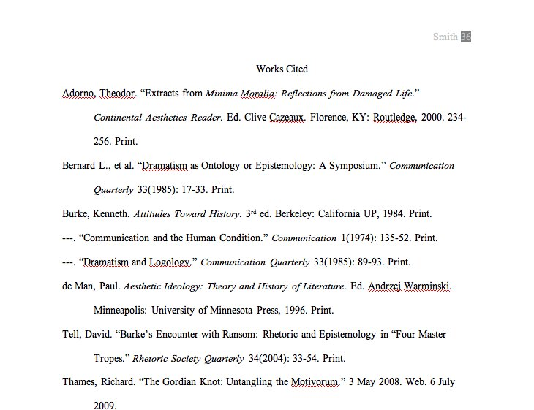
Sample Works Cited page
Alphabetize by first word (excluding ‘the’)
First line is “hanging”
Every line after first line is “indented”
Double-space
NO URLs anymore!!
Notes:
Basic Rules
･Begin your Works Cited page on a separate page at the end of your research paper. It should have the same one-inch margins and last name, page number header as the rest of your paper.
･Label the page Works Cited (do not italicize the words Works Cited or put them in quotation marks) and center the words Works Cited at the top of the page.
･Double space all citations, but do not skip spaces between entries.
･Indent the second and subsequent lines of citations five spaces so that you create a hanging indent.
･List page numbers of sources efficiently, when needed. If you refer to a journal article that appeared on pages 225 through 250, list the page numbers on your Works Cited page as 225-50.
Additional Basic Rules New to MLA 2009
･For every entry, you must determine the Medium of Publication. Most entries will likely be listed as Print or Web sources, but other possibilities may include Film, CD-ROM, or DVD.
･Writers are no longer required to provide URLs for Web entries. However, if your instructor or publisher insists on them, include them in angle brackets after the entry and end with a period. For long URLs, break lines only at slashes.
･If you're citing an article or a publication that was originally issued in print form but that you retrieved from an online database, you should type the online database name in italics. You do not need to provide subscription information in addition to the database name.Capitalization and Punctuation
･Capitalize each word in the titles of articles, books, etc, but do not capitalize articles, short prepositions, or conjunctions unless one is the first word of the title or subtitle
･New to MLA 2009: Use italics (instead of underlining) for titles of larger works (books, magazines) and quotation marks for titles of shorter works (poems, articles)
Listing Author Names
Entries are listed by author name (or, for entire edited collections, editor names). Author names are written last name first; middle names or middle initials follow the first name.
Do not list titles (Dr., Sir, Saint, etc.) or degrees (PhD, MA, DDS, etc.) with names. A book listing an author named "John Bigbrain, PhD" appears simply as "Bigbrain, John"; do, however, include suffixes like "Jr." or "II." Putting it all together, a work by Dr. Martin Luther King, Jr. would be cited as "King, Martin Luther, Jr.," with the suffix following the first or middle name and a comma.
More than One Work by an Author
If you have cited more than one work by a particular author, order the entries alphabetically by title, and use three hyphens in place of the author's name for every entry after the first.
Work with No Known Author
Alphabetize works with no known author by their title; use a shortened version of the title in the parenthetical citations in your paper.
15

